Slide 1
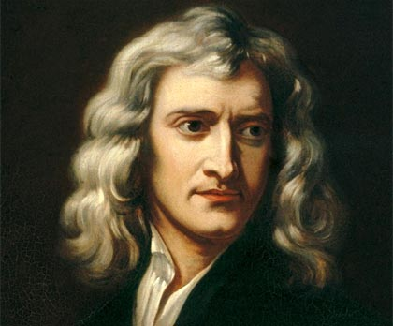
PHYS 2210
Lecture # 3
Vern Hart PhD
vhart@uvu.edu
“I can calculate the motion of heavenly bodies, but not the madness of people.”
-Isaac Newton

Slide 2
POD
A cannonball is launched with an initial velocity of 30 m/s at an angle of 26º. Find its initial velocity in the x and y directions.

Slide 3






I have a secret for you

Slide 4
Solving for motion in 2D and 3D is really easy
Because…

Slide 5
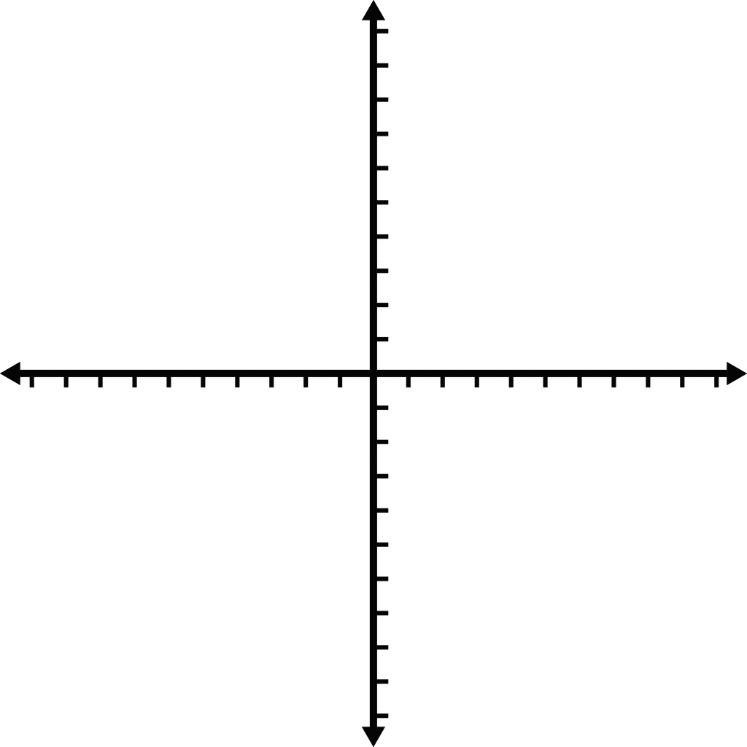
…of Orthogonality
What happens in x doesn’t affect y

Slide 6
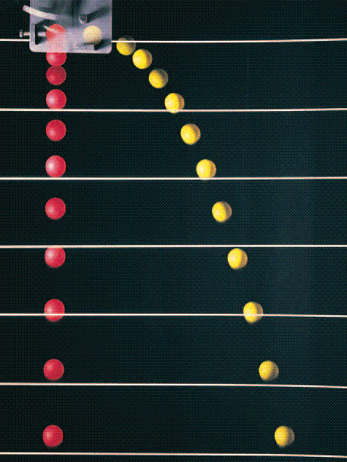

Slide 7
Bullet dropped/fired

Slide 8
Recall our definition for vectors
$$\overline{r}=x\hat{i}+y\hat{j}+z\hat{k}$$

Slide 9
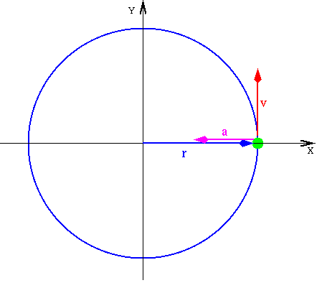
But vectors don’t have to be constant

Slide 10


Why not this?
$$\overline{r(t)}=x(t)\hat{i}+y(t)\hat{j}+z(t)\hat{k}$$
$$\overline{v(t)}=\frac{dx}{dt}\hat{i}+\frac{dy}{dt}\hat{j}+\frac{dz}{dt}\hat{k}$$
$$\overline{a(t)}=\frac{d^{2}x}{dt^{2}}\hat{i}+\frac{d^{2}y}{dt^{2}}\hat{j}+\frac{d^{2}z}{dt^{2}}\hat{k}$$

Slide 11
Try it
Suppose the position of a particle is given by the following vector function:
$$\overline{r(t)}=8t^{3}\hat{i}+sin⁡t\hat{j}+4\hat{k}$$
Find the acceleration of the particle after 3 seconds.

Slide 12
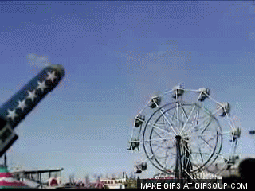
What is a projectile?
Any object which is launched and continues due to its own inertia.

Slide 13
Note: Gravity doesn’t have to be involved in projectile motion

Slide 14
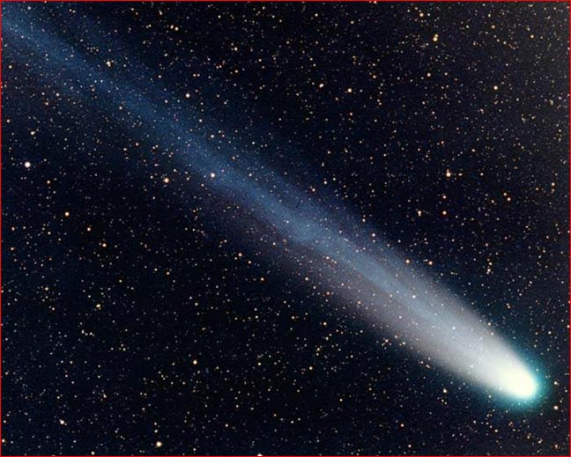
Is this a projectile?
Yes
Why?

Slide 15
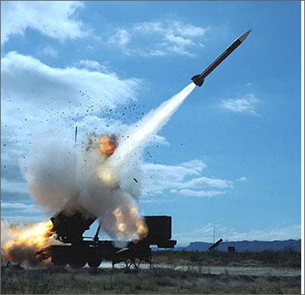
Is this a projectile?
No
Why not?

Slide 16
Then why do we always study projectiles with gravity?
We live on Earth
Without gravity, projectiles are super boring

Slide 17
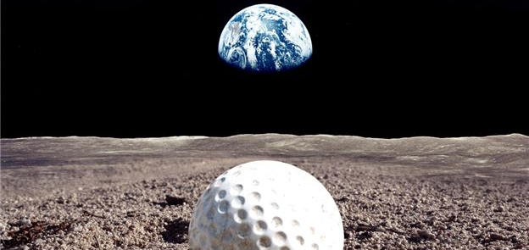
See what I mean

Slide 18
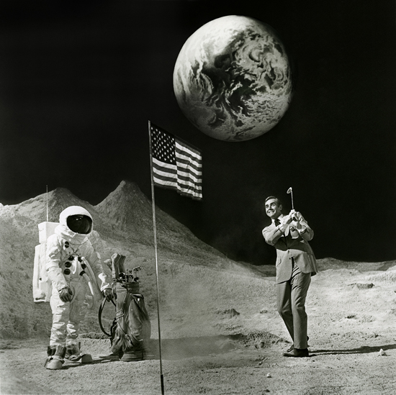
Straight lines are super boring

Slide 19

Curves are far more interesting
Dang it!
Dr. ♥ →
My leg!

Slide 20


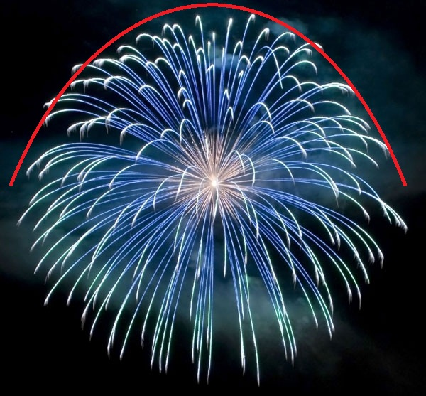
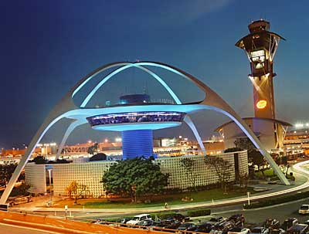
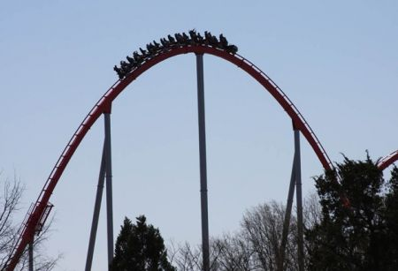
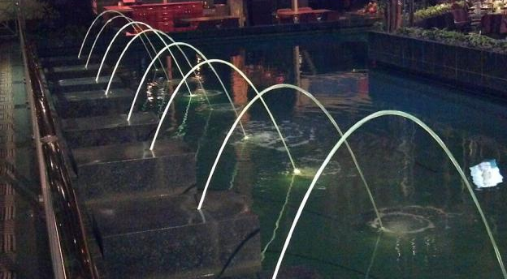
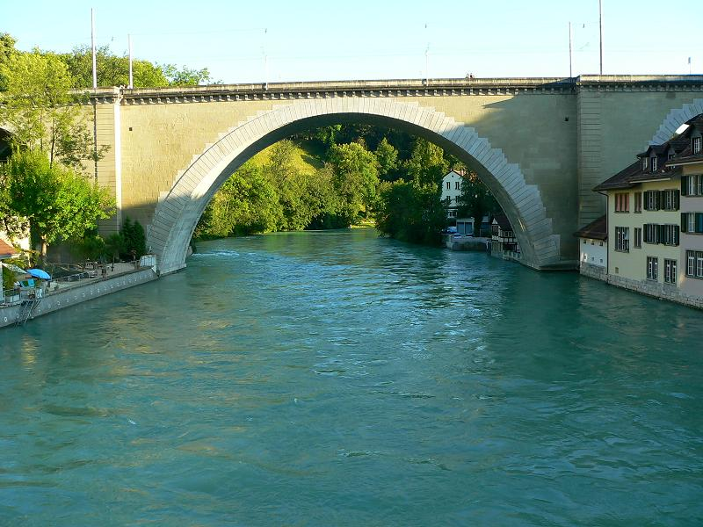
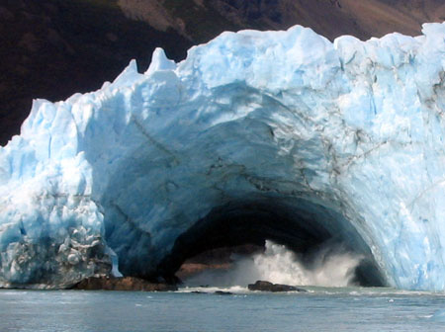

Nature absolutely loves them

Slide 21
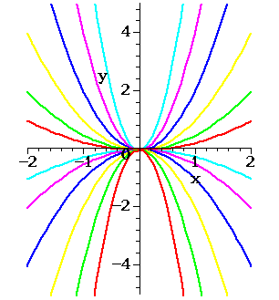
The trajectory of every free-moving object in a conservative force field traces the path of a…
Parabola!
Why? He he he

Slide 22
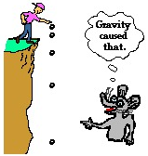
The creepiest picture ever?
∆y₁
∆y₂
∆y₃
∆y₄

Slide 23
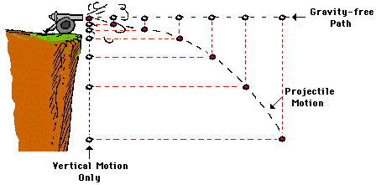
The same thing happens in 2D
∆y₁
∆y₂
∆y₃
∆y₄
Why?

Slide 24
3 unique classifications
Projectiles

Slide 25
Motion

Slide 26
Motion

Slide 27
Motion

Slide 28
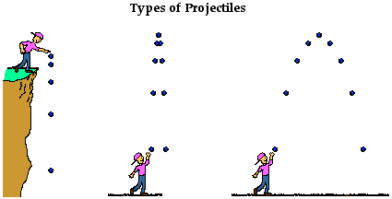
Vectors

Slide 29
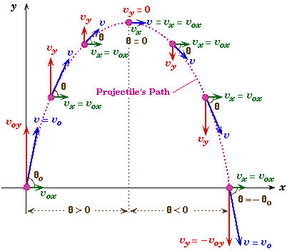

Slide 30

Question
That looks hard
How do we solve for projectiles in 2D?

Slide 31

And now, the moment you’ve been waiting for…
All of your ninja training has led to this…
The most famous problem in all of physics…
The birth of classical dynamics…
The problem so puzzling its solution was offered a king’s ransom…
The culmination of the entirety of your knowledge concerning Newtonian mechanics…

Slide 32
The Cannonball Problem

Slide 33
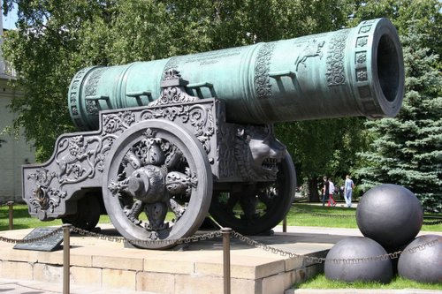

Suppose a cannonball is launched with an initial velocity of 30 m/s at an angle of 50º. How far from the cannon will the cannonball land?

Slide 34

Don’t worry, we’ll go through it together
In 4 easy steps!
Feel free to follow along with my simple step-by-step instructions. I make drawing fun!

Slide 35
Step 1: Draw an s for snake…
Just kidding, draw the problem. Be sure to include the initial velocity vector in your diagram.
Suppose a cannonball is launched with an initial velocity of 30 m/s at an angle of 50º. How far from the cannon will the cannonball land?

Slide 36
Step 2: Find the initial velocity in the x and y directions.

Slide 37
Step 3: Determine how long the projectile is in the air.

Slide 38
Step 4: Determine how far the object traveled horizontally during this time.
(See, I told you it was super easy)

Slide 39
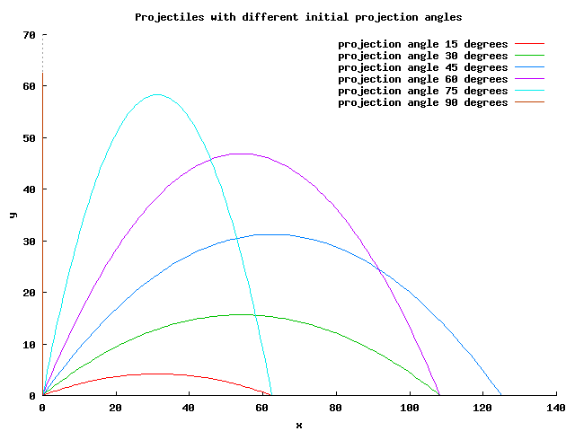

Slide 40
Projectiles
Projectiles

Slide 41
Your turn:
Suppose a cannon is placed on top of a 60m cliff. A cannonball if fired horizontally with an initial velocity of 40m/s. How far away from the cliff face will it land?

Slide 42
Suppose a cannonball is launched with an initial velocity of 30 m/s at an angle of 50º. Find the maximum height of the projectile.

Slide 43
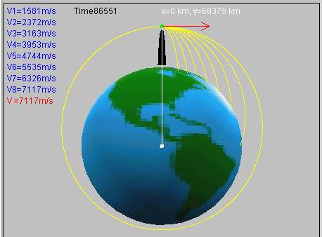

Slide 44
Orbits
Orbits

Slide 45
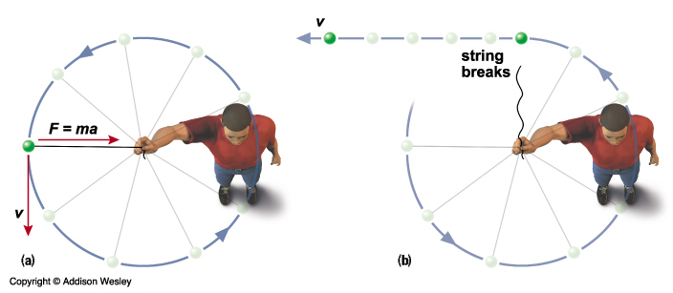
Force keeps objects in orbit

Slide 46
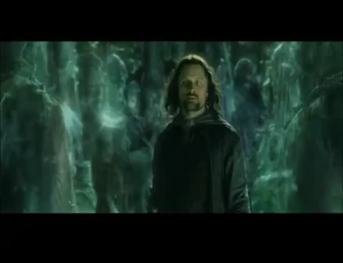
Question:
Suppose an object is traveling in a circle at a constant speed.
Is it accelerating?

Slide 47
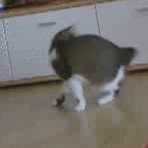
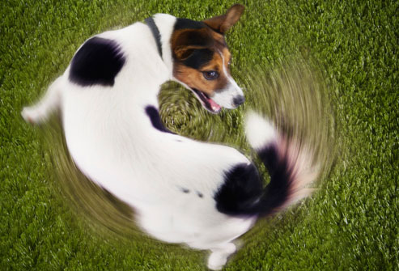
Accelerating?

Slide 48
Fact:
Velocity is a vector.
Vectors have a direction.

Slide 49
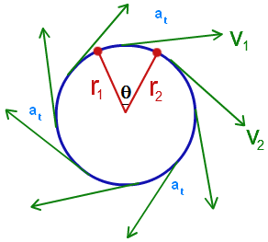
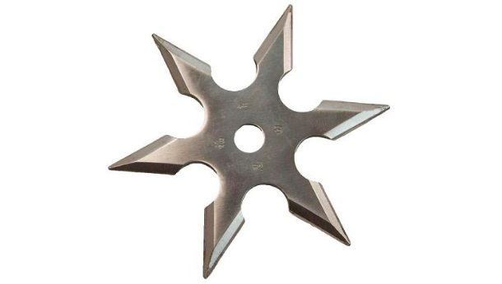
Acceleration

Slide 50
Question:
What causes acceleration?

Slide 51
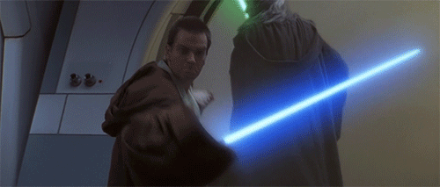
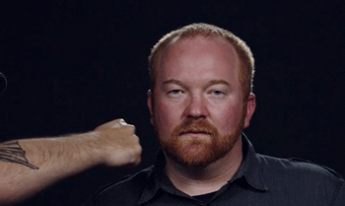
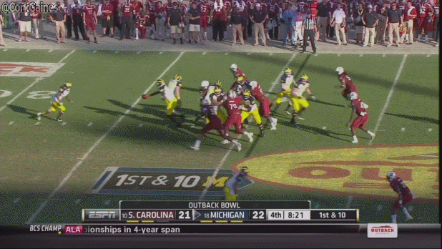
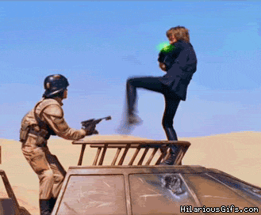
Force

Slide 52
Question:
What kind of force?

Slide 53
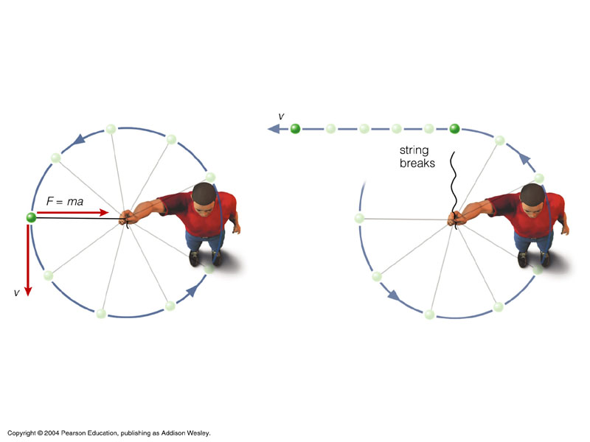
Centripetal Force
Is centrifugal force real?

Slide 54
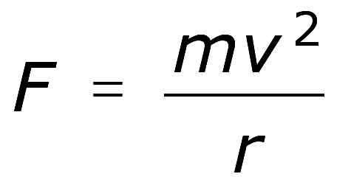
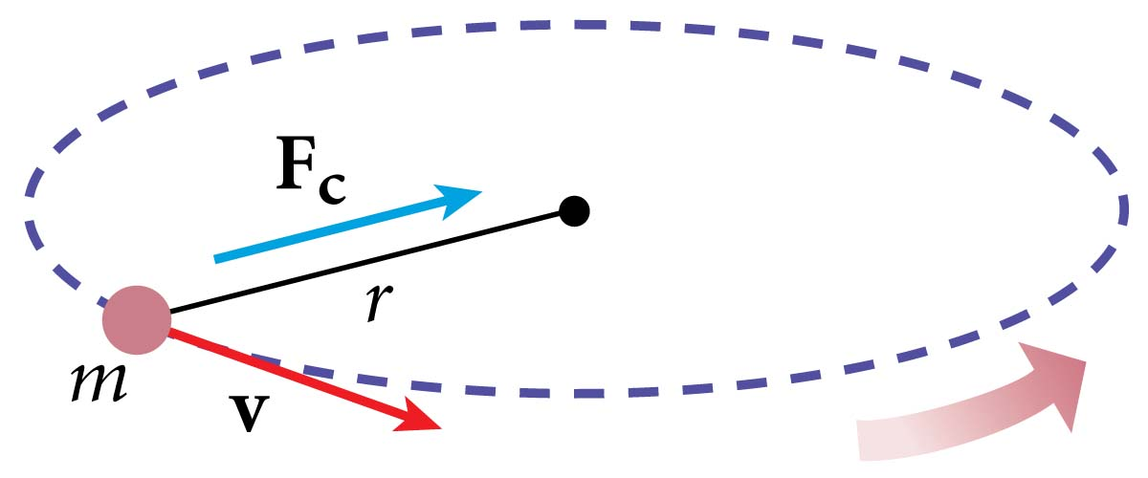
Centripetal Force

Slide 55
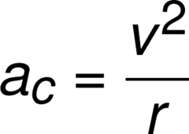
Centripetal Acceleration

Slide 56
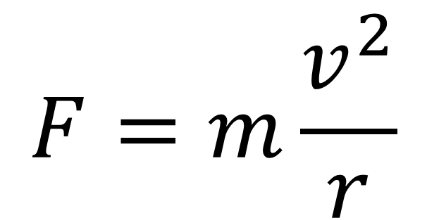
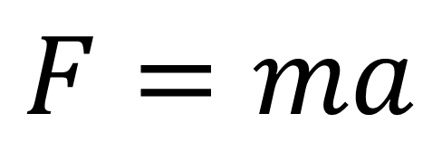
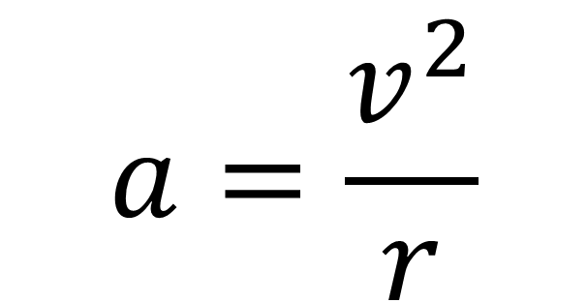
$$F=ma$$
$$F=m\frac{v^{2}}{r}$$
$$a=\frac{v^{2}}{r}$$

Slide 57
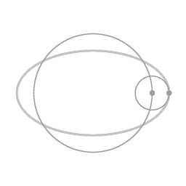
Period:
The amount of time it takes something to happen once
PMS jokes aren’t funny. Period.

Slide 58
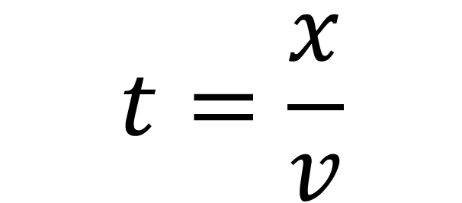
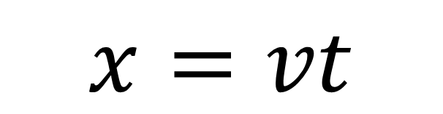
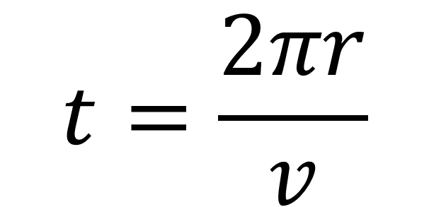
$$x=vt$$
$$t=\frac{x}{v}$$
$$t=\frac{2πr}{v}$$

Slide 59
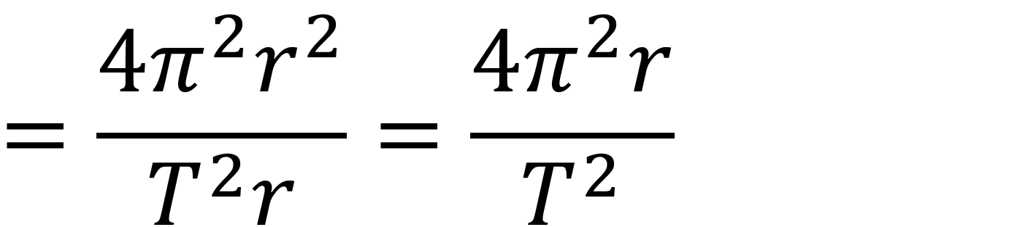
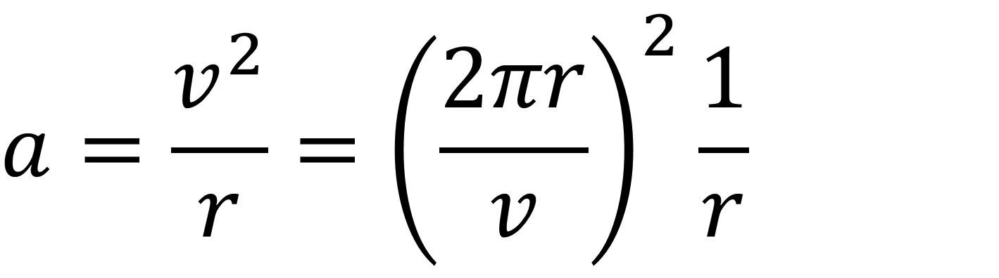
$$a=\frac{v^{2}}{r}={\left(\frac{2πr}{v}\right)}^{2}\frac{1}{r}$$
$$=\frac{{4π^{2}r}^{2}}{T^{2}r}=\frac{4π^{2}r}{T^{2}}$$

Slide 60
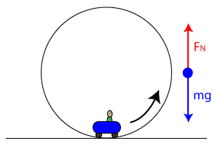
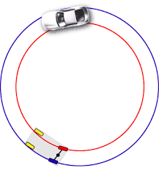
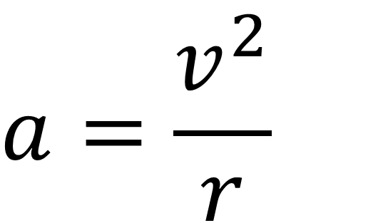
For things moving in circles:
$$a=\frac{v^{2}}{r}$$
$$F=m\frac{v^{2}}{r}$$

Slide 61
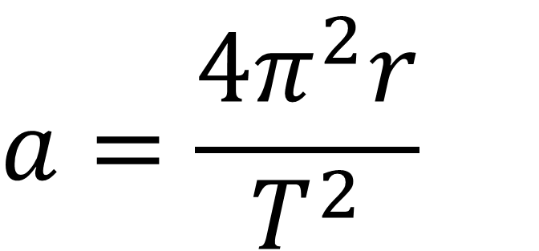

For things moving in circles:
$$T=\frac{2πr}{v}$$
$$a=\frac{4π^{2}r}{T^{2}}$$

Slide 62
Suppose a roller coaster car of mass 600 kg travels through a circular loop of radius 30 m at a velocity of 20 m/s. Find the centripetal acceleration of the car and the centripetal force needed to keep it on the track.

Slide 63
Suppose a satellite orbits earth with a velocity of 19000 m/s. If the altitude of the satellite is 32000 m, find the orbital period. (The radius of the of the earth is 6371000 m).

Slide 64

Suppose an airplane is flying due north at 320 m/s.
1: Draw its velocity vector relative to the ground?
2: How fast is it traveling relative to the ground?
3: In which direction is it traveling relative to the ground?

Slide 65


Slide 66
Suppose an airplane is flying due north at 320 m/s. The wind is blowing due north at 40 m/s.
1: Draw its velocity vector relative to the ground?
2: How fast is it traveling relative to the ground?
3: In which direction is it traveling relative to the ground?

Slide 68
Suppose an airplane is flying due north at 320 m/s. The wind is blowing due north at 40 m/s.
1: Draw its velocity vector relative to the wind?
2: How fast is it traveling relative to the wind?
3: In which direction is it traveling relative to the wind?

Slide 70
Suppose an airplane is flying due north at 320 m/s. The wind is blowing due east at 40 m/s.
1: Draw its velocity vector relative to the ground?
2: How fast is it traveling relative to the ground?
3: In which direction is it traveling relative to the ground?

Slide 72
Suppose an airplane is flying due north at 320 m/s. The wind is blowing due east at 40 m/s.
1: Draw its velocity vector relative to the wind?
2: How fast is it traveling relative to the wind?
3: In which direction is it traveling relative to the wind?

Slide 74
Suppose an airplane is flying 30º east of north at 320 m/s. The wind is blowing 20º south of east at 40 m/s.
1: Draw its velocity vector relative to the ground.
2: How fast is it traveling relative to the ground?
3: In which direction is it traveling relative to the ground?

